Slide 1
FSI Courses: Empowering Georgia Science Learning
Father-Son Innovations | Student Success | Teacher Mastery

Slide 2
The Problem
• Fragmented tools for students and teachers
• PD not directly connected to classroom content
• Districts struggle to prove ROI and CCRPI growth

Slide 3
The FSI Integrated Solution
One System — Two Audiences — Shared Results
• Interactive student science courses (Labs, Games, Assessments)
• Job-embedded teacher PD linked to the same standards
• Live dashboards connecting teacher fidelity to student mastery

Slide 4
How It Works
Step 1: Students engage with FSI interactive lessons and labs
Step 2: Teachers receive job-embedded PD while modeling those lessons
Step 3: Schools monitor student & teacher progress on one dashboard

Slide 5
Student Learning Features
• 100% Georgia Standards Aligned
• Gamified labs & real-world activities
• Tiered lessons for developing → proficient → distinguished
• Automatic Milestones-style pre/post testing

Slide 6
Teacher Professional Learning Features
• Co-teaching and lab modeling in real classrooms
• Virtual and onsite Milestones test taking prep sessions
• Reflection journals, checklists, and pacing guides
• Immediate classroom application from every PD module

Slide 7
The Secret Sauce
FSI = Engagement + Alignment + Support
• Job-embedded PD linked directly to student outcomes
• Tailored, hands-on learning for auditory, visual, and kinesthetic learners
• Local Georgia focus and unmatched service responsiveness

Slide 8
The Competitive Edge
Category | IXL / HMH | FSI Courses
Standards Alignment | National/Generic | 100% Georgia GSE
Student Engagement | Limited | Interactive labs & Games
Teacher PD | Separate/Generic | Embedded & Job-based
CCRPI Impact | Indirect | Directly linked
ROI | Split costs | Single Contract Savings

Slide 9
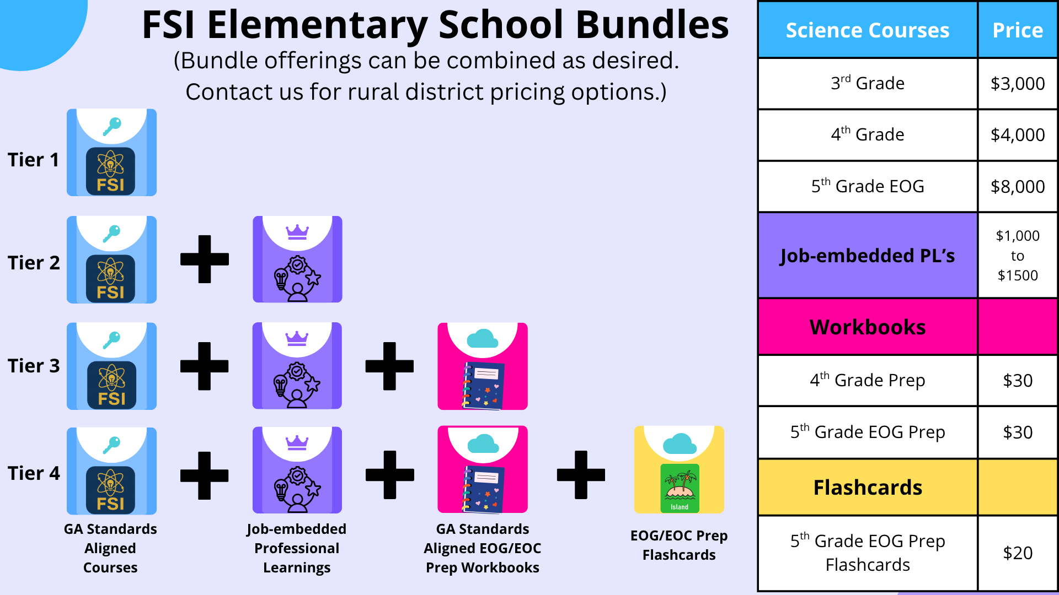
Pricing & ROI Tiers
“One platform, two outcomes — measurable student and teacher growth at half the cost.”

Slide 10
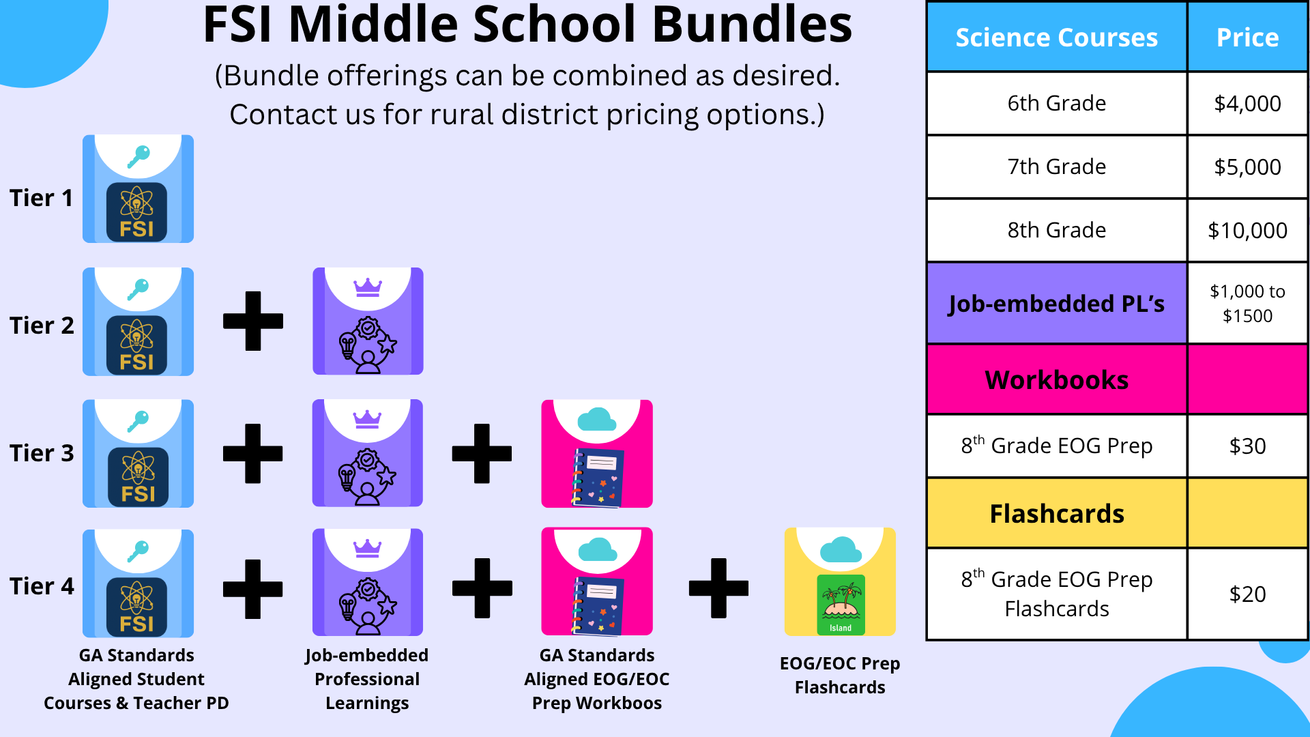
Pricing & ROI Tiers
“One platform, two outcomes — measurable student and teacher growth at half the cost.”

Slide 11
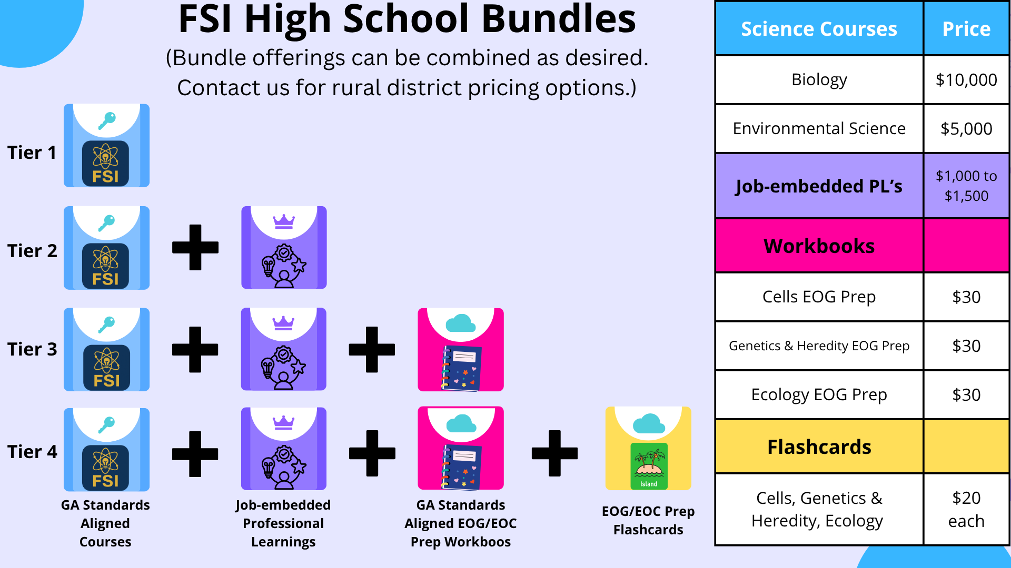
Pricing & ROI Tiers
“One platform, two outcomes — measurable student and teacher growth at half the cost.”

Slide 12
Menu of Services
• Job-embedded Professional Learning and Virtual Lesson Modeling
• Workbooks, Flashcards, and eBooks
• Consulting, Custom Curriculum Design, Pacing Guides

Slide 13
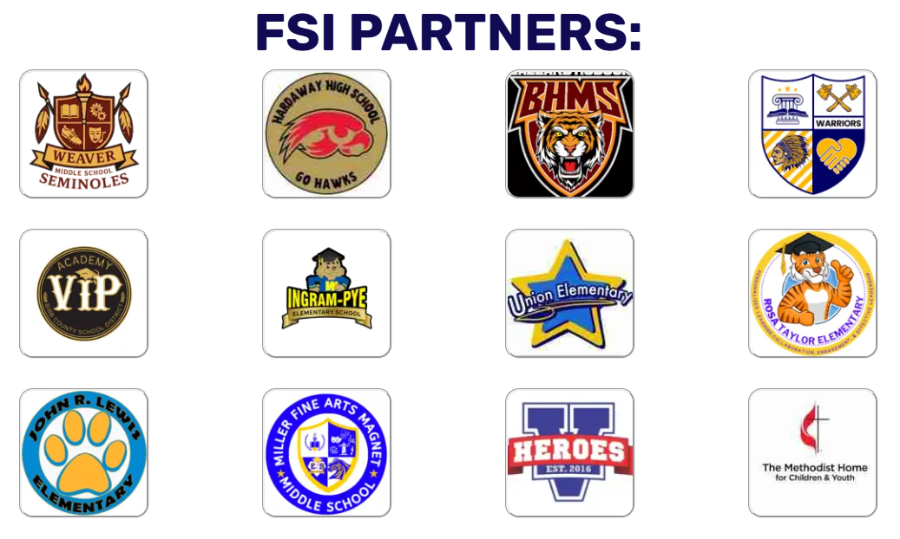
Proven Results
Every school we’ve partnered with has seen measurable improvement in CCRPI and Milestones readiness.

Slide 14

Call to Action
When teachers and students grow together, Georgia’s future shines brighter.
Let’s build mastery together — Book a Demo Today.
Visit: fsicourses.net

